Slide 1
Assembly Language for Intel-Based Computers, 4th Edition
Kip R. Irvine
Chapter 6: Conditional Processing
Slides prepared by Kip R. Irvine
Revision date: 3/15/2006
Chapter corrections (Web) Assembly language sources (Web)
(c) Pearson Education, 2002. All rights reserved. You may modify and copy this slide show for your personal use, or for use in the classroom, as long as this copyright statement, the author's name, and the title are not changed.

Slide 2
Chapter Overview
Boolean and Comparison Instructions
Conditional Jumps
Conditional Loop Instructions
Conditional Structures
Using the .IF Directive
Irvine, Kip R. Assembly Language for Intel-Based Computers, 2003.

Slide 3
Boolean and Comparison Instructions
CPU Status Flags
AND Instruction
OR Instruction
XOR Instruction
NOT Instruction
Applications
TEST Instruction
CMP Instruction
Irvine, Kip R. Assembly Language for Intel-Based Computers, 2003.

Slide 4
Status Flags - Review
The Zero flag is set when the result of an operation equals zero.
The Carry flag is set when an instruction generates a result that is too large (or too small) for the destination operand.
The Sign flag is set if the destination operand is negative, and it is clear if the destination operand is positive.
The Overflow flag is set when an instruction generates an invalid signed result (bit 7 carry is XORed with bit 6 Carry).
The Parity flag is set when an instruction generates an even number of 1 bits in the low byte of the destination operand.
The Auxiliary Carry flag is set when an operation produces a carry out from bit 3 to bit 4
Irvine, Kip R. Assembly Language for Intel-Based Computers, 2003.

Slide 5


AND Instruction
Performs a Boolean AND operation between each pair of matching bits in two operands
Syntax:
    AND destination, source
  (same operand types as MOV)
AND
Irvine, Kip R. Assembly Language for Intel-Based Computers, 2003.

Slide 6


OR Instruction
Performs a Boolean OR operation between each pair of matching bits in two operands
Syntax:
    OR destination, source
OR
Irvine, Kip R. Assembly Language for Intel-Based Computers, 2003.

Slide 7

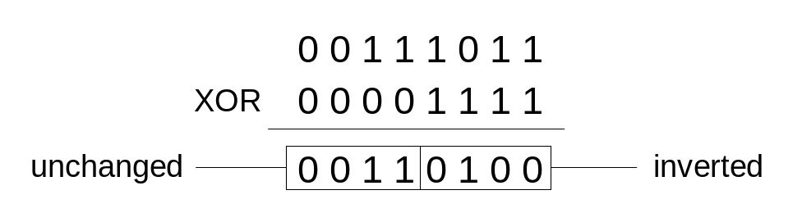
XOR Instruction
Performs a Boolean exclusive-OR operation between each pair of matching bits in two operands
Syntax:
    XOR destination, source
XOR
XOR is a useful way to toggle (invert) the bits in an operand.
Irvine, Kip R. Assembly Language for Intel-Based Computers, 2003.

Slide 8

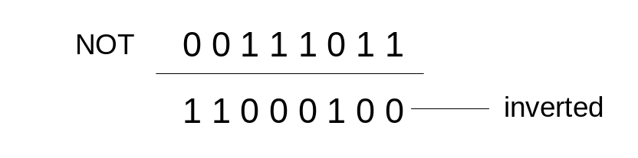
NOT Instruction
Performs a Boolean NOT operation on a single destination operand
Syntax:
    NOT destination
NOT
Irvine, Kip R. Assembly Language for Intel-Based Computers, 2003.

Slide 9
Applications (1 of 2)
Task: Convert the character in AL to upper case.
Solution: Use the AND instruction to clear bit 5.
mov al,'a' ; AL = 01100001b
and al,11011111b ; AL = 01000001b
Irvine, Kip R. Assembly Language for Intel-Based Computers, 2003.

Slide 10
Applications (2 of 2)
Task: Convert a binary decimal byte into its equivalent ASCII decimal digit.
Solution: Use the OR instruction to set bits 4 and 5.
mov al,6 ; AL = 00000110b
or al,00110000b ; AL = 00110110b
The ASCII digit '6' = 00110110b
Irvine, Kip R. Assembly Language for Intel-Based Computers, 2003.

Slide 11
TEST Instruction
Performs a nondestructive AND operation between each pair of matching bits in two operands
No operands are modified, but the Zero flag is affected.
Example: jump to a label if either bit 0 or bit 1 in AL is set.
test al,00000011b
jnz ValueFound
Example: jump to a label if neither bit 0 nor bit 1 in AL is set.
test al,00000011b
jz ValueNotFound
Irvine, Kip R. Assembly Language for Intel-Based Computers, 2003.

Slide 12
CMP Instruction (1 of 3)
Compares the destination operand to the source operand
  Nondestructive subtraction of source from destination (destination operand is not changed)
Syntax: CMP destination, source
Example: destination == source
mov al,5
cmp al,5 ; Zero flag set
Example: destination < source
mov al,4
cmp al,5 ; Carry flag set
Irvine, Kip R. Assembly Language for Intel-Based Computers, 2003.

Slide 13
CMP Instruction (2 of 3)
Example: destination > source
mov al,6
cmp al,5 ; ZF = 0, CF = 0
(both the Zero and Carry flags are clear)
Irvine, Kip R. Assembly Language for Intel-Based Computers, 2003.

Slide 14
CMP Instruction (3 of 3)
The comparisons shown here are performed with signed integers.
Example: destination > source
mov al,5
cmp al,-2 ; Sign flag == Overflow flag
Example: destination < source
mov al,-1
cmp al,5 ; Sign flag != Overflow flag
Irvine, Kip R. Assembly Language for Intel-Based Computers, 2003.

Slide 15
Conditional Jumps
Jumps Based On . . .
  Specific flags
  Equality
  Unsigned comparisons
  Signed Comparisons
Applications
Encrypting a String
Bit Test (BT) Instruction
Irvine, Kip R. Assembly Language for Intel-Based Computers, 2003.

Slide 16
Jcond Instruction
A conditional jump instruction branches to a label when specific register or flag conditions are met
Examples:
  JB, JC jump to a label if the Carry flag is set
  JE, JZ jump to a label if the Zero flag is set
  JS jumps to a label if the Sign flag is set
  JNE, JNZ jump to a label if the Zero flag is clear
  JECXZ jumps to a label if ECX equals 0
Irvine, Kip R. Assembly Language for Intel-Based Computers, 2003.

Slide 17
Jcond Ranges
Prior to the 386:
  jump must be within –128 to +127 bytes from current location counter
IA-32 processors:
  32-bit offset permits jump anywhere in memory
Irvine, Kip R. Assembly Language for Intel-Based Computers, 2003.

Slide 18
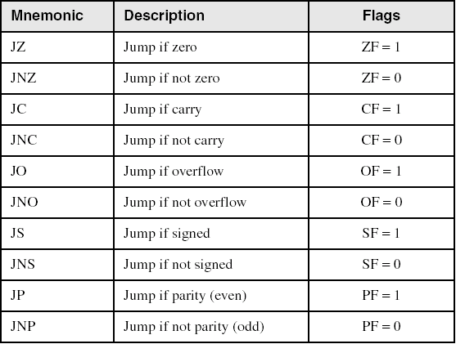
Jumps Based on Specific Flags
Irvine, Kip R. Assembly Language for Intel-Based Computers, 2003.

Slide 19
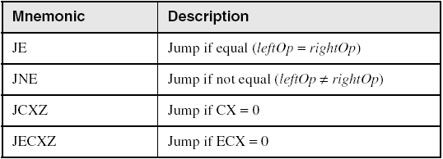
Jumps Based on Equality
Irvine, Kip R. Assembly Language for Intel-Based Computers, 2003.

Slide 20
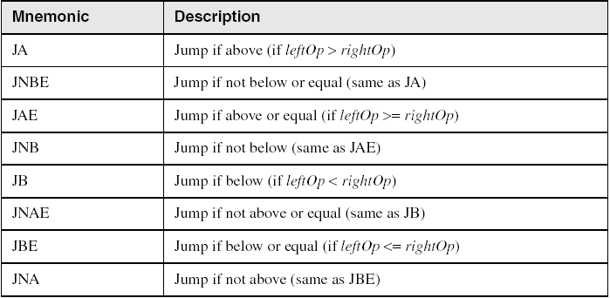
Jumps Based on Unsigned Comparisons
Irvine, Kip R. Assembly Language for Intel-Based Computers, 2003.

Slide 21
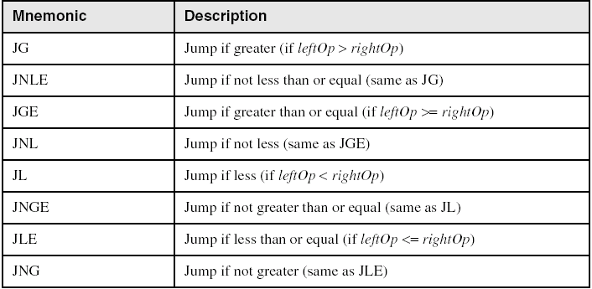
Jumps Based on Signed Comparisons
Irvine, Kip R. Assembly Language for Intel-Based Computers, 2003.

Slide 22
Applications (1 of 5)
Task: Jump to a label if unsigned EAX is greater than EBX
Solution: Use CMP, followed by JA
cmp eax,ebx
ja Larger
Task: Jump to a label if signed EAX is greater than EBX
Solution: Use CMP, followed by JG
cmp eax,ebx
jg Greater
Irvine, Kip R. Assembly Language for Intel-Based Computers, 2003.

Slide 23
Applications (2 of 5)
Jump to label L1 if unsigned EAX is less than or equal to Val1
cmp eax,Val1
jbe L1 ; below or equal
Jump to label L1 if signed EAX is less than or equal to Val1
cmp eax,Val1
jle L1
Irvine, Kip R. Assembly Language for Intel-Based Computers, 2003.

Slide 24
Applications (3 of 5)
Compare unsigned AX to BX, and copy the larger of the two into a variable named Large
  mov Large,bx
  cmp ax,bx
  jna Next
  mov Large,ax
Next:
Compare signed AX to BX, and copy the smaller of the two into a variable named Small
  mov Small,ax
  cmp bx,ax
  jnl Next
  mov Small,bx
Next:
Irvine, Kip R. Assembly Language for Intel-Based Computers, 2003.

Slide 25
Applications (4 of 5)
Jump to label L1 if the memory word pointed to by ESI equals Zero
  cmp WORD PTR [esi],0
  je L1
Jump to label L2 if the doubleword in memory pointed to by EDI is even
test DWORD PTR [edi],1
jz L2
Irvine, Kip R. Assembly Language for Intel-Based Computers, 2003.

Slide 26
Applications (5 of 5)
Task: Jump to label L1 if bits 0, 1, and 3 in AL are all set.
Solution: Clear all bits except bits 0, 1,and 3. Then compare the result with 00001011 binary.
and al,00001011b ; clear unwanted bits
cmp al,00001011b ; check remaining bits
je L1 ; all set? jump to L1
Irvine, Kip R. Assembly Language for Intel-Based Computers, 2003.

Slide 27
BT (Bit Test) Instruction
Copies bit n from an operand into the Carry flag
Syntax: BT bitBase, n
  bitBase may be r/m16 or r/m32
  n may be r16, r32, or imm8
Example: jump to label L1 if bit 9 is set in the AX register:
bt AX,9 ; CF = bit 9
jc L1 ; jump if Carry
Irvine, Kip R. Assembly Language for Intel-Based Computers, 2003.

Slide 28
Conditional Loop Instructions
LOOPZ and LOOPE
LOOPNZ and LOOPNE
Irvine, Kip R. Assembly Language for Intel-Based Computers, 2003.

Slide 29
LOOPZ and LOOPE
Syntax:
  LOOPE destination
  LOOPZ destination
Logic:
  ECX ← ECX – 1
  if ECX > 0 and ZF=1, jump to destination
Useful when scanning an array for the first element that does not match a given value.
Irvine, Kip R. Assembly Language for Intel-Based Computers, 2003.

Slide 30
LOOPNZ and LOOPNE
LOOPNZ (LOOPNE) is a conditional loop instruction
Syntax:
LOOPNZ destination
LOOPNE destination
Logic:
  ECX ← ECX – 1;
  if ECX > 0 and ZF=0, jump to destination
Useful when scanning an array for the first element that matches a given value.
Irvine, Kip R. Assembly Language for Intel-Based Computers, 2003.

Slide 31
LOOPNZ Example
The following code finds the first positive value in an array:
.data
array SWORD -3,-6,-1,-10,10,30,40,4
sentinel SWORD 0
.code
  mov esi,OFFSET array
  mov ecx,LENGTHOF array
next:
  test WORD PTR [esi],8000h ; test sign bit
  pushfd ; push flags on stack
  add esi,TYPE array
  popfd ; pop flags from stack
  loopnz next ; continue loop
  jnz quit ; none found
  sub esi,TYPE array ; ESI points to value
quit:
Irvine, Kip R. Assembly Language for Intel-Based Computers, 2003.

Slide 32
Your turn . . .
Locate the first nonzero value in the array. If none is found, let ESI point to the sentinel value:
.data
array SWORD 50 DUP(?)
sentinel SWORD 0FFFFh
.code
  mov esi,OFFSET array
  mov ecx,LENGTHOF array
L1: cmp WORD PTR [esi],0 ; check for zero
(fill in your code here)
quit:
Irvine, Kip R. Assembly Language for Intel-Based Computers, 2003.

Slide 33
. . . (solution)
.data
array SWORD 50 DUP(?)
sentinel SWORD 0FFFFh
.code
  mov esi,OFFSET array
  mov ecx,LENGTHOF array
L1: cmp WORD PTR [esi],0 ; check for zero
  pushfd ; push flags on stack
  add esi,TYPE array
  popfd ; pop flags from stack
  loope L1 ; continue loop
  jz quit ; none found
  sub esi,TYPE array ; ESI points to value
quit:
Irvine, Kip R. Assembly Language for Intel-Based Computers, 2003.

Slide 34
Conditional Structures
Block-Structured IF Statements
Compound Expressions with AND
Compound Expressions with OR
WHILE Loops
Irvine, Kip R. Assembly Language for Intel-Based Computers, 2003.

Slide 35
Block-Structured IF Statements
Assembly language programmers can easily translate logical statements written in C++/Java into assembly language. For example:
if( op1 == op2 )
X = 1;
else
X = 2;
  mov eax,op1
  cmp eax,op2
  jne L1
  mov X,1
  jmp L2
L1: mov X,2
L2:
Irvine, Kip R. Assembly Language for Intel-Based Computers, 2003.

Slide 36
Your turn . . .
Implement the following pseudocode in assembly language. All values are unsigned:
if( ebx <= ecx )
{
eax = 5;
edx = 6;
}
  cmp ebx,ecx
  ja next
  mov eax,5
  mov edx,6
next:
(There are multiple correct solutions to this problem.)
Irvine, Kip R. Assembly Language for Intel-Based Computers, 2003.

Slide 37
Your turn . . .
Implement the following pseudocode in assembly language. All values are 32-bit signed integers:
if( var1 <= var2 )
var3 = 10;
else
{
var3 = 6;
var4 = 7;
}
  mov eax,var1
  cmp eax,var2
  jle L1
  mov var3,6
  mov var4,7
  jmp L2
L1: mov var3,10
L2:
(There are multiple correct solutions to this problem.)
Irvine, Kip R. Assembly Language for Intel-Based Computers, 2003.

Slide 38
Compound Expression with AND (1 of 3)
When implementing the logical AND operator, consider that HLLs use short-circuit evaluation
In the following example, if the first expression is false, the second expression is skipped:
if (al > bl) AND (bl > cl)
X = 1;
Irvine, Kip R. Assembly Language for Intel-Based Computers, 2003.

Slide 39
Compound Expression with AND (2 of 3)
if (al > bl) AND (bl > cl)
X = 1;
This is one possible implementation . . .
cmp al,bl ; first expression...
ja L1
jmp next
L1:
cmp bl,cl ; second expression...
ja L2
jmp next
L2: ; both are true
mov X,1 ; set X to 1
next:
Irvine, Kip R. Assembly Language for Intel-Based Computers, 2003.

Slide 40
Compound Expression with AND (3 of 3)
if (al > bl) AND (bl > cl)
X = 1;
But the following implementation uses 29% less code by reversing the first relational operator. We allow the program to "fall through" to the second expression:
cmp al,bl ; first expression...
jbe next ; quit if false
cmp bl,cl ; second expression...
jbe next ; quit if false
mov X,1 ; both are true
next:
Irvine, Kip R. Assembly Language for Intel-Based Computers, 2003.

Slide 41
Your turn . . .
Implement the following pseudocode in assembly language. All values are unsigned:
if( ebx <= ecx
&& ecx > edx )
{
eax = 5;
edx = 6;
}
  cmp ebx,ecx
  ja next
  cmp ecx,edx
  jbe next
  mov eax,5
  mov edx,6
next:
(There are multiple correct solutions to this problem.)
Irvine, Kip R. Assembly Language for Intel-Based Computers, 2003.

Slide 42
Compound Expression with OR (1 of 2)
When implementing the logical OR operator, consider that HLLs use short-circuit evaluation
In the following example, if the first expression is true, the second expression is skipped:
if (al > bl) OR (bl > cl)
X = 1;
Irvine, Kip R. Assembly Language for Intel-Based Computers, 2003.

Slide 43
Compound Expression with OR (1 of 2)
if (al > bl) OR (bl > cl)
X = 1;
We can use "fall-through" logic to keep the code as short as possible:
cmp al,bl ; is AL > BL?
ja L1 ; yes
cmp bl,cl ; no: is BL > CL?
jbe next ; no: skip next statement
L1: mov X,1 ; set X to 1
next:
Irvine, Kip R. Assembly Language for Intel-Based Computers, 2003.

Slide 44
WHILE Loops
A WHILE loop is really an IF statement followed by the body of the loop, followed by an unconditional jump to the top of the loop. Consider the following example:
while( eax < ebx)
eax = eax + 1;
This is a possible implementation:
top: cmp eax,ebx ; check loop condition
jae next ; false? exit loop
inc eax ; body of loop
jmp top ; repeat the loop
next:
Irvine, Kip R. Assembly Language for Intel-Based Computers, 2003.

Slide 45
Your turn . . .
Implement the following loop, using unsigned 32-bit integers:
while( ebx <= val1)
{
ebx = ebx + 5;
val1 = val1 - 1
}
top: cmp ebx,val1 ; check loop condition
ja next ; false? exit loop
add ebx,5 ; body of loop
dec val1
jmp top ; repeat the loop
next:
Irvine, Kip R. Assembly Language for Intel-Based Computers, 2003.

Slide 46
Using the .IF Directive
Runtime Expressions
Relational and Logical Operators
MASM-Generated Code
.REPEAT Directive
.WHILE Directive
Irvine, Kip R. Assembly Language for Intel-Based Computers, 2003.

Slide 47
Runtime Expressions
.IF, .ELSE, .ELSEIF, and .ENDIF can be used to evaluate runtime expressions and create block-structured IF statements.
Examples:
.IF eax > ebx
mov edx,1
.ELSE
mov edx,2
.ENDIF
.IF eax > ebx && eax > ecx
mov edx,1
.ELSE
mov edx,2
.ENDIF
MASM generates "hidden" code for you, consisting of code labels, CMP and conditional jump instructions.
Irvine, Kip R. Assembly Language for Intel-Based Computers, 2003.

Slide 48
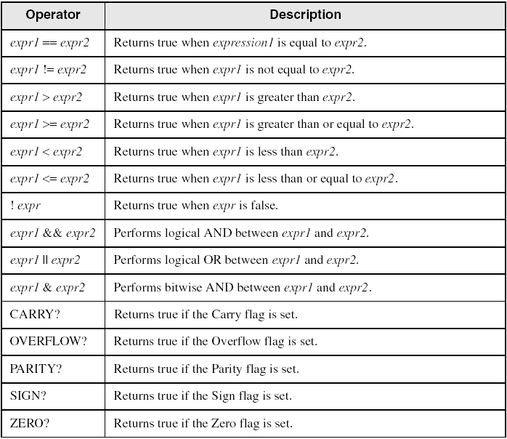
Relational and Logical Operators
Irvine, Kip R. Assembly Language for Intel-Based Computers, 2003.

Slide 49
MASM-Generated Code
.data
val1 DWORD 5
result DWORD ?
.code
mov eax,6
.IF eax > val1
mov result,1
.ENDIF
Generated code:
mov eax,6
cmp eax,val1
jbe @C0001
mov result,1
@C0001:
MASM automatically generates an unsigned jump (JBE) because val1 is unsigned.
Irvine, Kip R. Assembly Language for Intel-Based Computers, 2003.

Slide 50
MASM-Generated Code
.data
val1 SDWORD 5
result SDWORD ?
.code
mov eax,6
.IF eax > val1
mov result,1
.ENDIF
Generated code:
mov eax,6
cmp eax,val1
jle @C0001
mov result,1
@C0001:
MASM automatically generates a signed jump (JLE) because val1 is signed.
Irvine, Kip R. Assembly Language for Intel-Based Computers, 2003.

Slide 51
MASM-Generated Code
.data
result DWORD ?
.code
mov ebx,5
mov eax,6
.IF eax > ebx
mov result,1
.ENDIF
Generated code:
mov ebx,5
mov eax,6
cmp eax,ebx
jbe @C0001
mov result,1
@C0001:
MASM automatically generates an unsigned jump (JBE) when both operands are registers . . .
Irvine, Kip R. Assembly Language for Intel-Based Computers, 2003.

Slide 52
MASM-Generated Code
.data
result SDWORD ?
.code
mov ebx,5
mov eax,6
.IF SDWORD PTR eax > ebx
mov result,1
.ENDIF
Generated code:
mov ebx,5
mov eax,6
cmp eax,ebx
jle @C0001
mov result,1
@C0001:
. . . unless you prefix one of the register operands with the SDWORD PTR operator. Then a signed jump is generated.
Irvine, Kip R. Assembly Language for Intel-Based Computers, 2003.

Slide 53
.REPEAT Directive
Executes the loop body before testing the loop condition associated with the .UNTIL directive.
Example:
; Display integers 1 – 10:
mov eax,0
.REPEAT
inc eax
call WriteDec
call Crlf
.UNTIL eax == 10
Irvine, Kip R. Assembly Language for Intel-Based Computers, 2003.

Slide 54
.WHILE Directive
Tests the loop condition before executing the loop body The .ENDW directive marks the end of the loop.
Example:
; Display integers 1 – 10:
mov eax,0
.WHILE eax < 10
inc eax
call WriteDec
call Crlf
.ENDW
Irvine, Kip R. Assembly Language for Intel-Based Computers, 2003.

Slide 55

The End
Irvine, Kip R. Assembly Language for Intel-Based Computers, 2003.

